Slide 1
Gene Expression–Based Molecular Generation Using
Deep Learning
 |  | Group 6

Slide 2
content
01
04
Methodology
Research Background
02
05
Result
Dataset
03
06
Conclusion
Evaluation Metrics

Slide 3
01
Research Background
Gene expression profiles capture global cellular responses to drugs or genetic perturbations
They reflect pathway activation and downstream regulatory changes
Serve as a bridge linking chemical structures and biological functions
Traditional molecular generation is chemistry-centric
Limited ability to incorporate transcriptomic (gene expression) information
Key idea:
Compounds targeting the same gene or pathway tend to produce similar gene expression profiles
-> Enables gene expression-guided molecular generation
-> Provides a biologically informed direction for drug design
3

Slide 4
01
Research Background
Related Work:
Transcriptome GAN (2020)
First attempt at direct generation
Very low validity (~8.5%)
TRIOMPHE (2021–2024)
Retrieval-based approach
Generate molecules around known structures
GxRNN (2024)
Direct conditional generation using RNN
Improved stability
4

Slide 5
02
Dataset
Gene expression data
LINCS L1000 (MCF7 cells, 10 µM)
Level 5 consensus signatures
Molecular data
Canonical SMILES from PubChem
Removed sequences with length > 80
Data split: Train : Validation = 9 : 1
Condition inputs
8 gene knockdowns (e.g., AKT, EGFR, MTOR) and 2 gene overexpression (SMAD3, TP53)
Reference ligands
ExCAPE-DB for evaluation
5

Slide 6
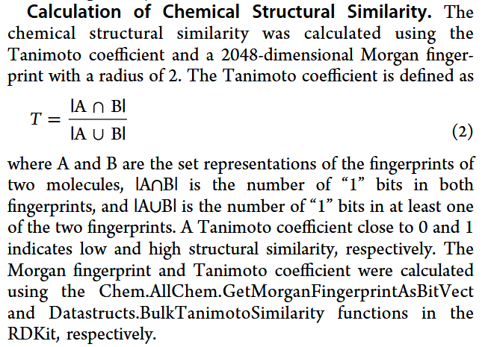
03
Evaluation Metrics
Evaluate similarity between generated molecules and known ligands
Based on the same target-specific gene expression condition
Higher similarity -> better biological relevance
Reflects both chemical plausibility and target consistency
6

Slide 7
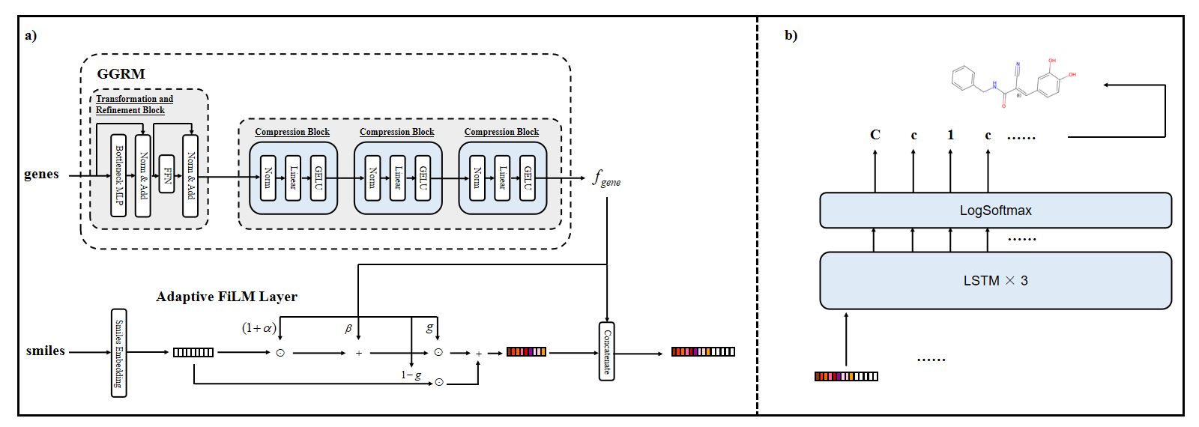
04
Methodology
Encode gene expression into regulatory embeddings
Use Adaptive FiLM to condition molecular features
Feed conditioned features into LSTM decoder
Generate molecules autoregressively (SMILES)
7

Slide 8
04
Methodology
Encode high-dimensional gene expression data
Capture gene-gene relationships
Reduce dimensionality into compact embeddings
Preserve key biological signals
Output used as conditioning input
8

Slide 9
04
Methodology
Integrates gene expression embeddings into generation
Modulates SMILES token features
Uses feature-wise scaling and shifting
Includes a gating mechanism
Enables dynamic and fine-grained conditioning
9

Slide 10
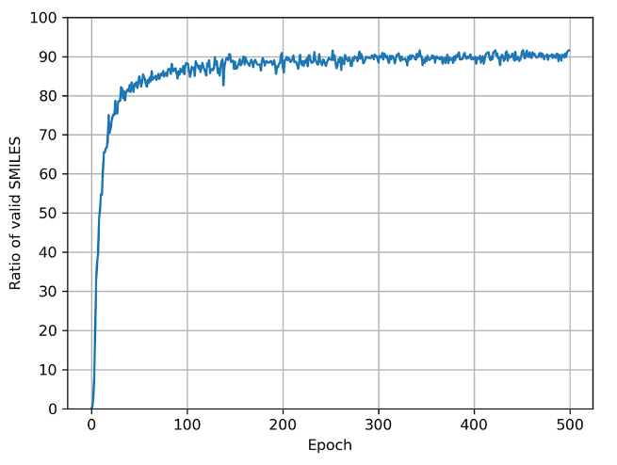
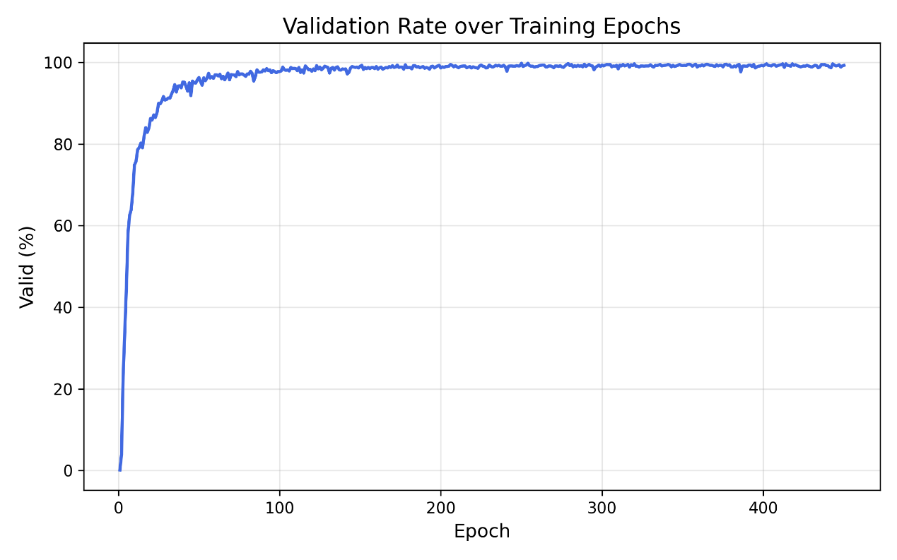
05
Result
Baseline: gradual increase, limited performance
Our model: fast convergence, high validity
Achieves near 100% valid SMILES -> Significant improvement over baseline
10

Slide 11
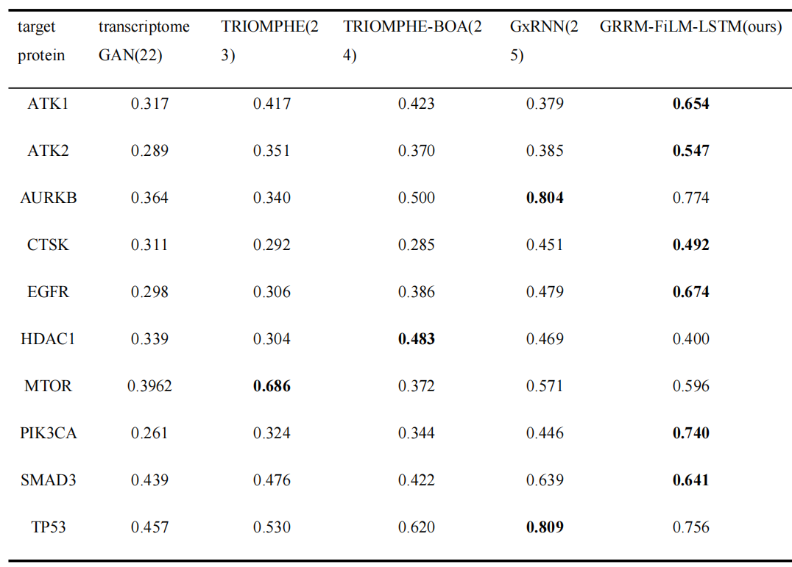
05
Result
Achieves highest similarity on 6/10 targets
Ranks among top performers on most tasks
Generated molecules align well with target-specific profiles
-> Strong biological relevance
11

Slide 12
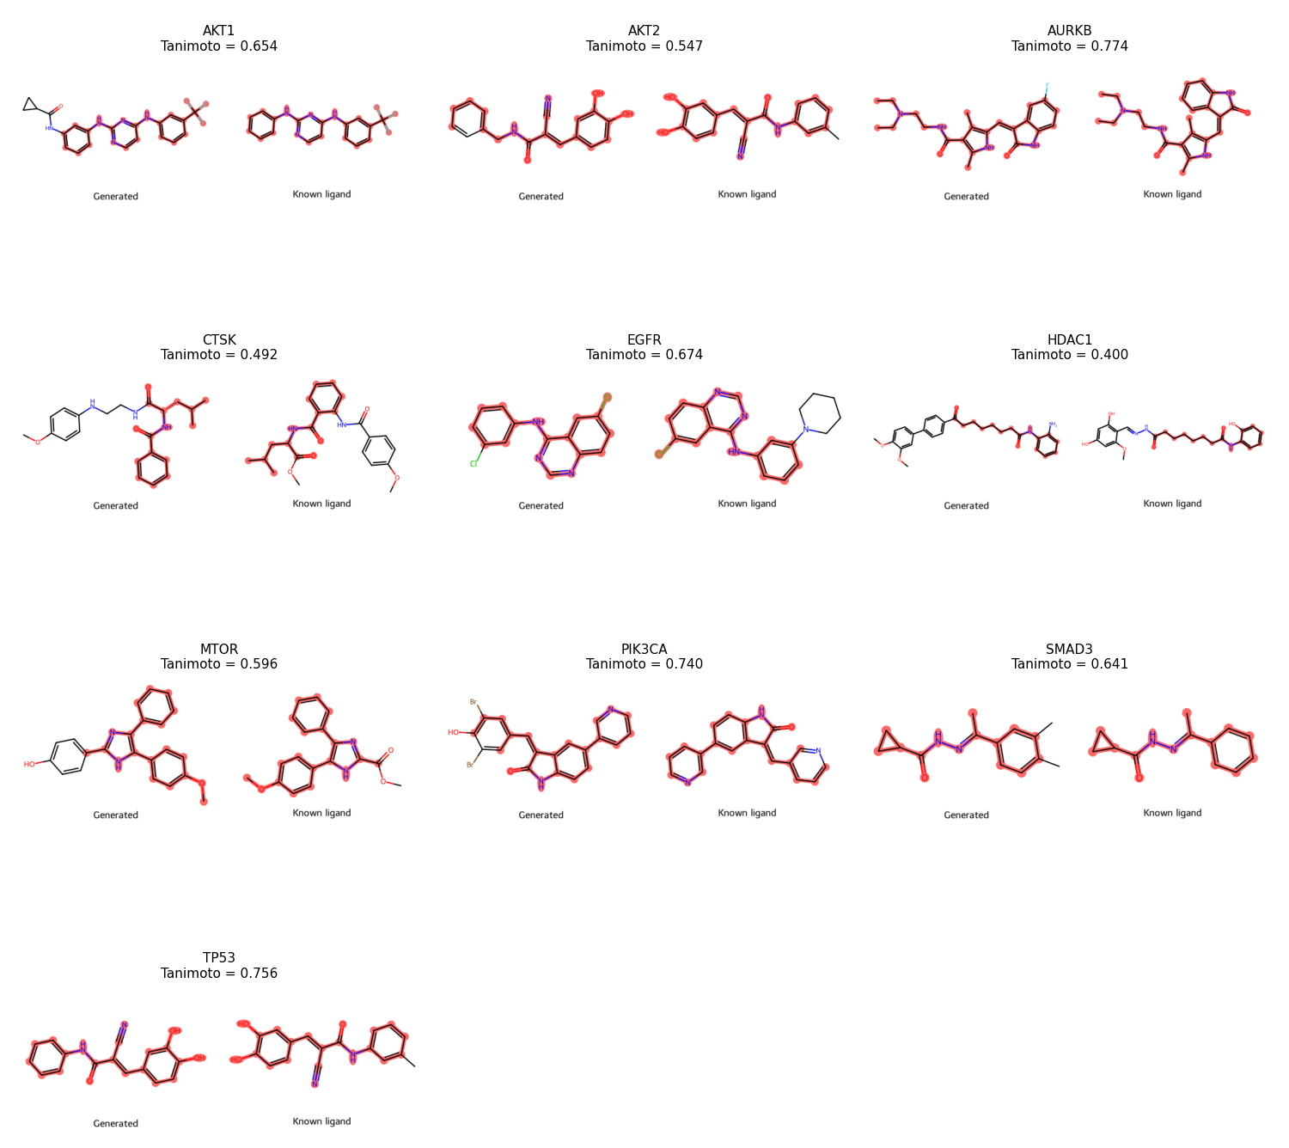
05
Result
12

Slide 13
06
Conclusion
Proposed a gene expression-conditioned molecular generation framework
Integrates GRRM + Adaptive FiLM for biological guidance
Achieves high validity and improved stability
Shows strong structural similarity performance
Provides a promising direction for drug design
13

Slide 14

Thank you

